Slide 1
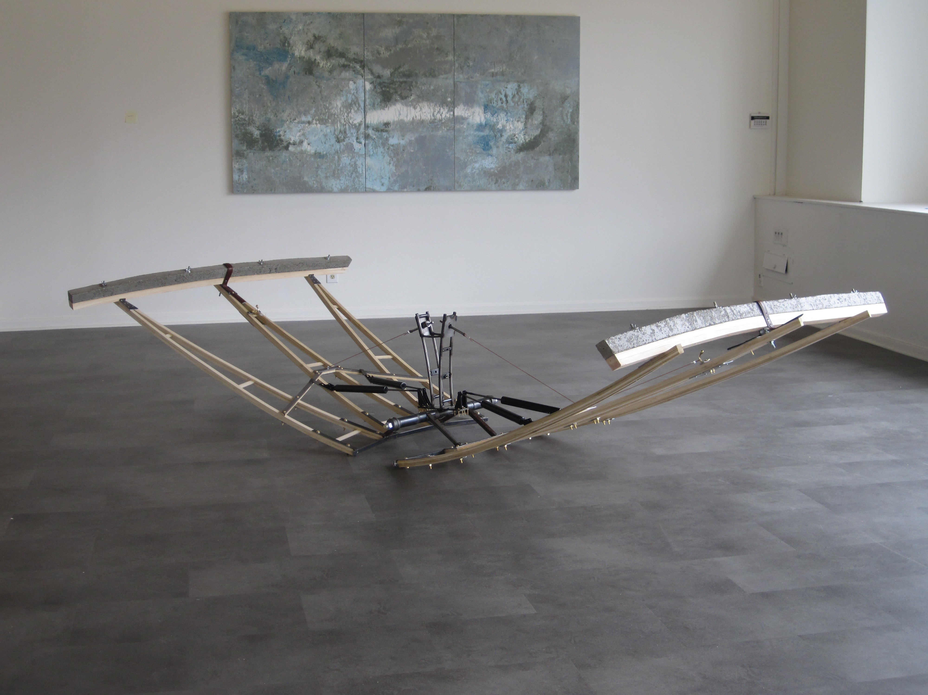
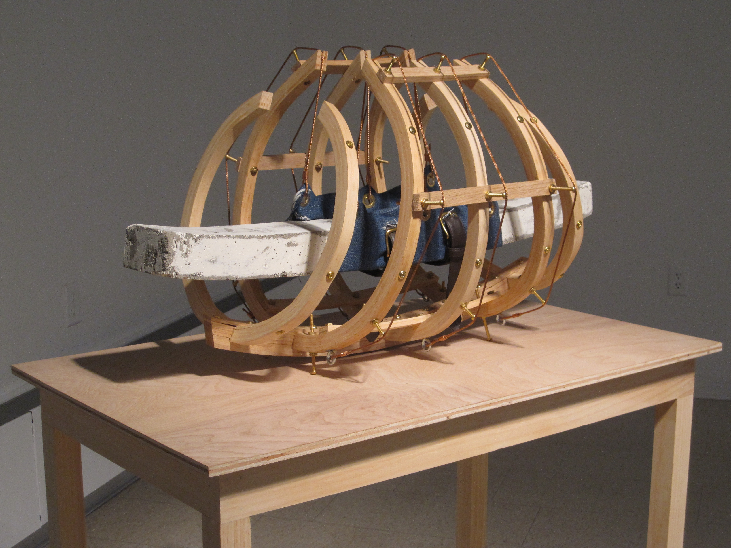
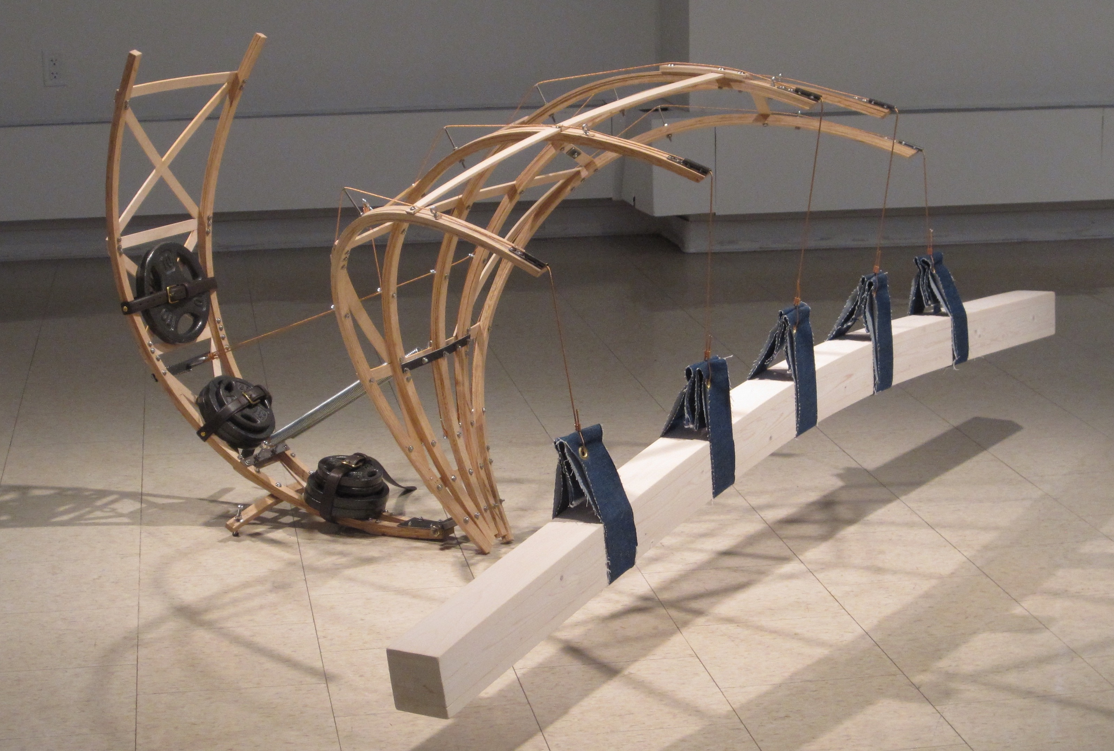
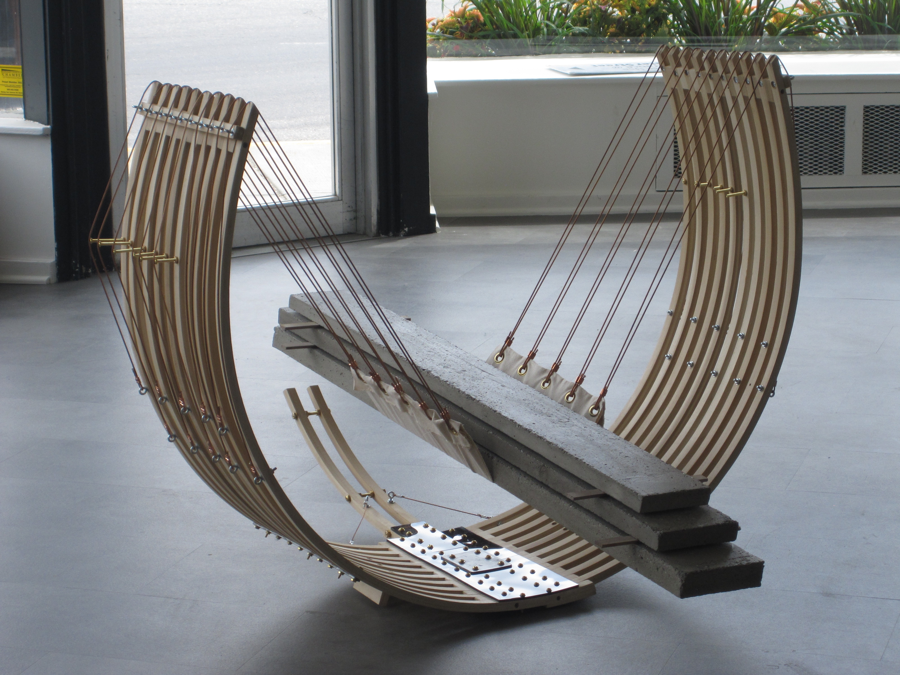
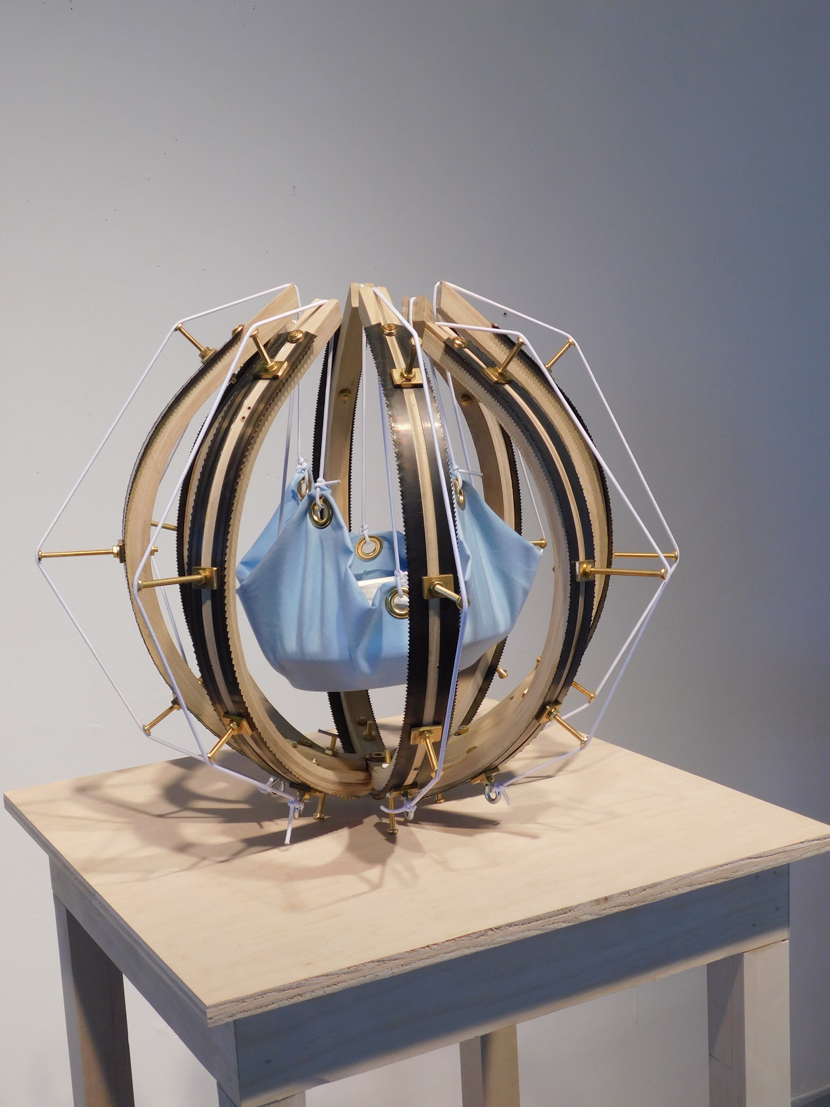
Suspension for Substratum
Poplar, Steel, Hardware
125x47x33 inches
$5,000
Cradle for Weight of Significance
Pine, Red Oak, Bronze Wire, Brass Hardware
25x15x15 inches
$2,000
Purlin Under Deformation
Pine, Steel, Bronze Wire, Found Objects
96x56x38 inches
$3,500
Cradle for Foundation Slabs
Poplar, Concrete, Bronze Wire, Hardware
44x34x48 inches
$3,000
Cradle for Significant Weight
Plaster, Pine, Found Objects, Hardware
18x18x16 inches
$1,000

Slide 2
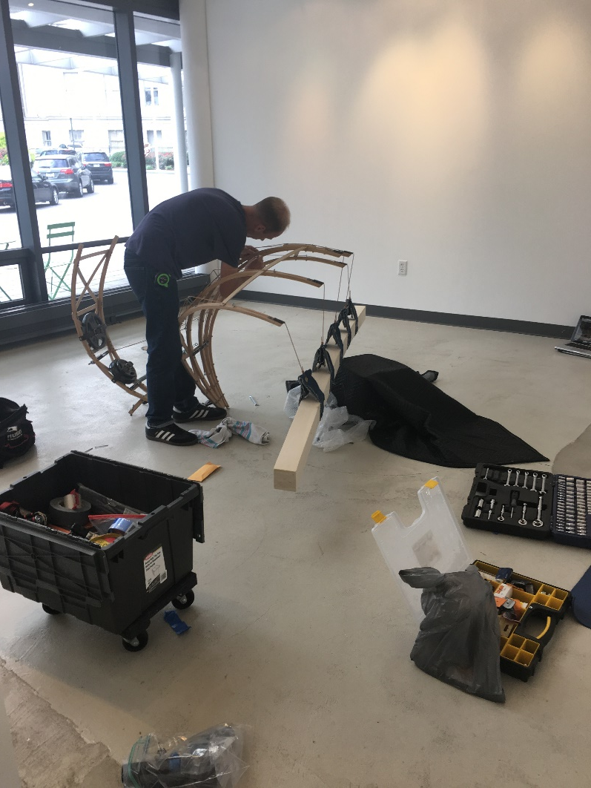
INSTRUMENTS OF RESPITE
By Michael Donovan
Michael Donovan explores the act of
preservation by creating implements that
maintain an actuated state through their utility. Implements provide respite from physical
exertion and metaphorical alleviation from potential overwhelm. Michael received his MFA in Sculpture from the University of Connecticut, Storrs, CT and his BS in Studio Art/Sculpture from Southern Connecticut State University, New Haven, CT.
http://michaelfdonovan.wixsite.com/michaeldonovan
Gallery hrs: M-Saturday, 8:30am-5:30pm
Sundays see security for entry
Offsite Gallery
World Trade Center
101 W. Main St. Norfolk, VA 23510

